Slide 1

Executing a Sprint
- Prof K G Krishna

Slide 2



Text/Reference Books
T1
T2
Compliments of IBM
➔ As this field is evolutionary, the student is advised to stay tuned to the current and emerging practices by referring to their own organization’s documentation as well as Net sources

Slide 3
Topics
Executing a Sprint
Sprint Ceremonies.
Daily Scrums, Scrum of Scrums
Sprint Review
Sprint Retrospective

Slide 4
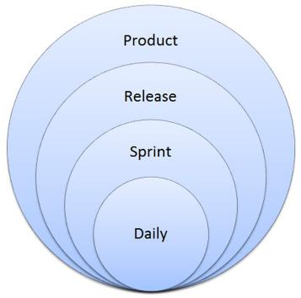
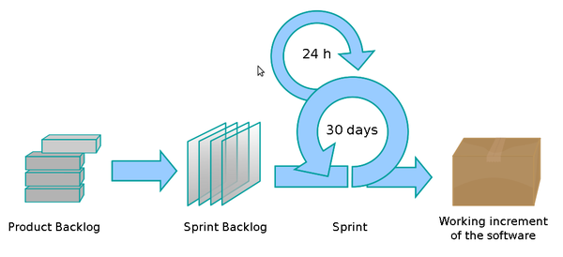
Levels of Planning in Agile
Product Vision (1 – 3 years)
Release Planning

Slide 5
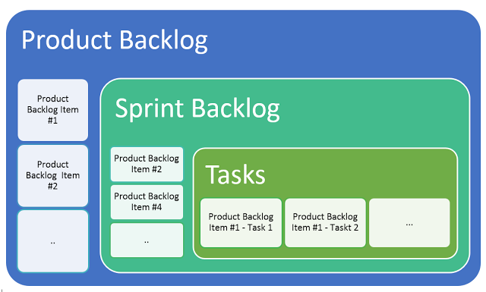
Product-backlog vs. Sprint-backlog vs. Tasks/User Stories

Slide 6
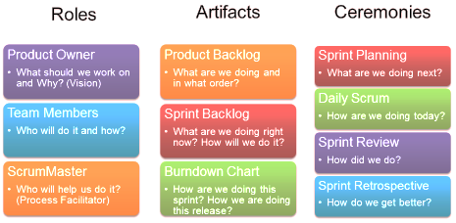
Scrum: Roles – Artifacts - Ceremonies

Slide 7
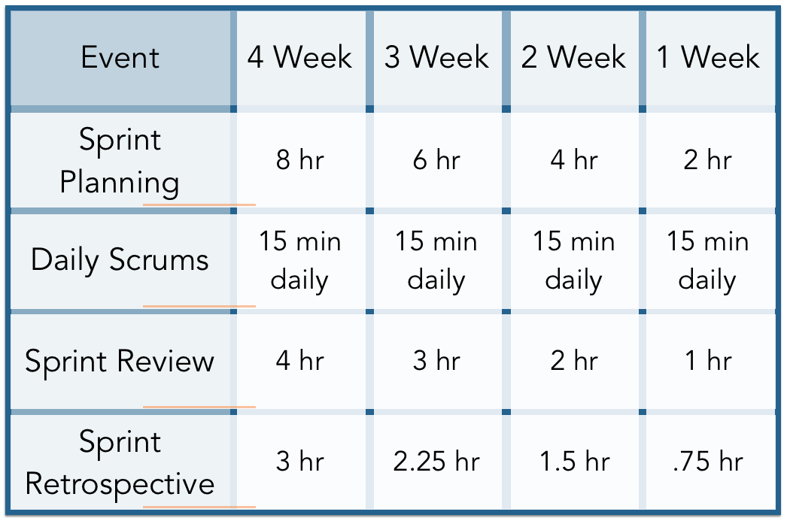
Sprint Ceremonies (Meetings) – A Snapshot

Slide 8
Sprint-backlog – an Overview
Within an agile development project, a sprint backlog is a list of the tasks and requirements to be completed within the sprint. The sprint backlog includes
The list of user stories within the sprint in order of priority.
The relative effort estimate for each user story.
The tasks necessary to develop each user story.
The effort, in hours, to complete each task (Each task should take one day or less for the development team to complete)
A burndown chart that shows the status of the work the development team has completed.
The development team collaborates to create and maintain the sprint backlog, and only the development team can modify the sprint backlog. The sprint backlog should reflect an up-to-the-day snapshot of the sprint’s progress
Ref: (T2-Chap9)

Slide 9
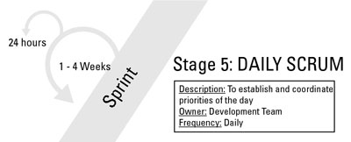
Daily Scrum Meeting
Scrum meeting is a Stand-up meeting lasting not more than 15-20 minutes
Anyone may attend a daily scrum, but only the development team, the scrum master, and the product owner may talk. Stakeholders can discuss questions with the scrum master or product owner afterward, but stakeholders should not approach the development team.
Focus on immediate priorities. The scrum team should review only completed tasks, tasks to be done, and roadblocks.
Use the meeting for coordination, not problem-solving. The development team and the scrum master are responsible for removing roadblocks during the day. To keep meetings from drifting into problem-solving sessions, scrum teams can Keep a list on a white board to keep track of issues that need immediate attention, and then address those issues directly after the meeting.
Hold a meeting, called an after-party, to solve problems when the daily scrum is finished. Some scrum teams schedule time for an after-party every day; others only meet as needed.
The daily scrum is for peer-to-peer coordination. Save status reports for the sprint backlog.
The scrum team may request that daily scrum attendees stand up — rather than sit down — during the meeting. Standing up makes people eager to finish the meeting and get on with the day’s work
Ref: (T2-Chap9)

Slide 10
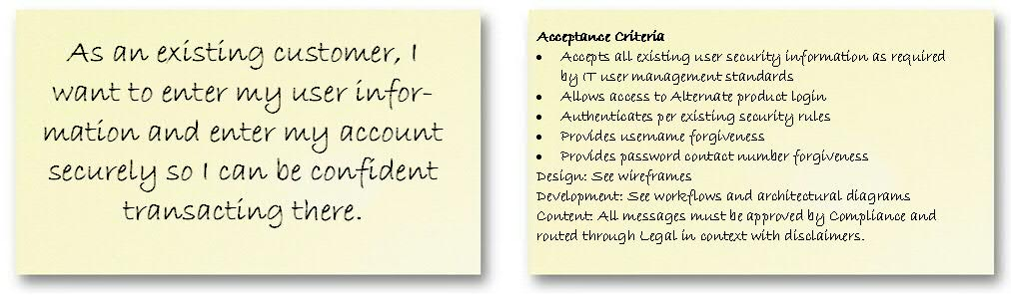
Executing Sprint
Creating Shippable Functionality
The objective of the day-to-day work of a sprint is to create shippable functionality for the product in a form that can be delivered to a customer or user.
To create shippable functionality, the development team and the product owner are involved in following major activities:
Elaborating (responding to clarifications, detailing of new features)
Developing the Stories/Tasks (the actual work by team)
Verifying (automated testing, peer review, and product owner review)
Identifying Roadblocks (using organizational cloud, Scrum Master removes roadblocks related to resources, shields team from extra-project activities)
Update Sprint Burndown chart and Sprint-backlog at the end of the day
Ref: (T2-Chap9)

Slide 11
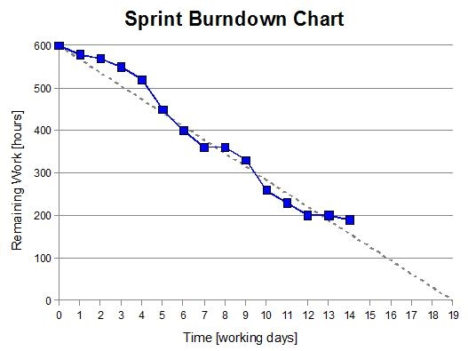
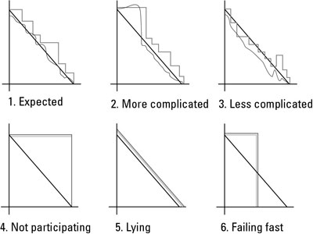
Tracking Progress: Sprint Burndown Chart
Ref: (T2-Chap9)

Slide 12
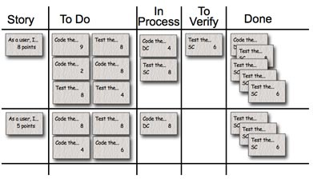
Tracking Progress: Sprint Task-board
Task board — in conjunction with the sprint backlog (which is an electronic version) — gives a quick, easy view of status of the items within the sprint to the development team
The task board can be made up of sticky notes on a white board.
Task board to be always visible and accessible to members – they can physically move a user story card through its completion
The task board encourages thought and action just by existing in the scrum team’s work area, where everyone can see the board.
Ref: (T2-Chap9)

Slide 13
Progress Tracking through Burndown Charts
Expected: This chart shows a normal sprint pattern. The remaining work hours rise and fall as the development team completes tasks, ferrets out details,
More complicated: In this sprint, the work increased beyond the point in which the development team felt it could accomplish everything. The team identified this issue early, worked with the product owner to remove some user stories, and still achieved the sprint goal. The key to scope changes within a sprint is that they are always initiated by the development team — no one else.
Less complicated: In this sprint, the development team completed some critical user stories faster than anticipated and worked with the product owner to identify additional user stories it could add to the sprint.
Not participating: A straight line in a burndown means that the team didn’t update the burndown or made zero progress that day. Either case is a red flag for future problems.
Lying (or conforming): This burndown pattern is common for new agile development teams used to reporting the hours management expects instead of the time the work really takes. A team with this chart likely adjusted its work estimates to the exact number of remaining hours. This pattern often reflects a fear-based environment, where the managers lead by intimidation.
Failing fast: One of the strongest benefits of agile is the immediate proof of progress, or lack thereof. This pattern shows an example of a team that wasn’t participating or progressing. Halfway through the sprint, the product owners cut their losses and killed the sprint. Only product owners can end a sprint early.
Ref: (T2-Chap9)

Slide 14
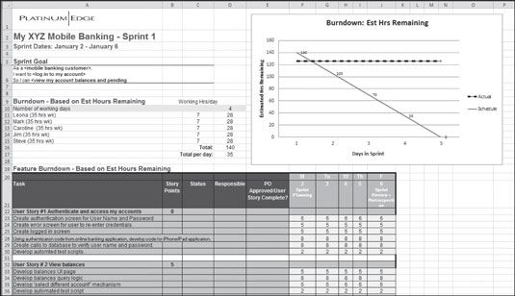
Sprint-backlog Example
Source: (T2-Chap9)

Slide 15
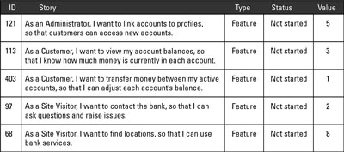
Sprint-backlog – An Example

Slide 16
Scaling Agile: Scrum of Scrums
To Scale Teams beyond 7 members to large Groups
Divide the Group into Scrum Groups of 5 – 7 each
A technique to scale Scrum up to large groups (over a dozen people), consisting of dividing the groups into Agile teams of 5-10. Each daily scrum within a sub-team ends by designating one member as "ambassador" to participate in a daily meeting with ambassadors from other teams
The Scrum of Scrums proceeds otherwise as a normal daily meeting, with ambassadors reporting completions, next steps and impediments on behalf of the teams they represent. Resolution of impediments is expected to focus on the challenges of coordination between the teams; solutions may entail agreeing to interfaces between teams, negotiating responsibility boundaries, etc.
The Scrum of Scrum will track these items via a backlog of its own, where each item contributes to improving between-team coordination.
Ref: (T2-Chap9)

Slide 17
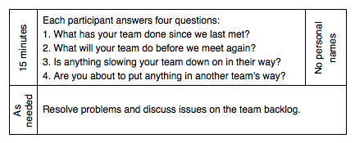
Scrum of Scrums (contd.,)
The scrum of scrums meetings can be scaled up in a recursive manner – more scrum of scrums meetings. Each contains a representative from each of the teams. The work of scrum of scrums meetings can be coordinated through an even higher level meeting (“scrum of scrum of scrums”)
Scrum of scrums meetings may not be daily
Agenda - similar to the standard agenda for the daily scrum except the team member represents his own scrum team.
Ref: (T2-Chap9)

Slide 18
Sprint Reviews & Sprint Retrospectives
➔➔

Slide 19
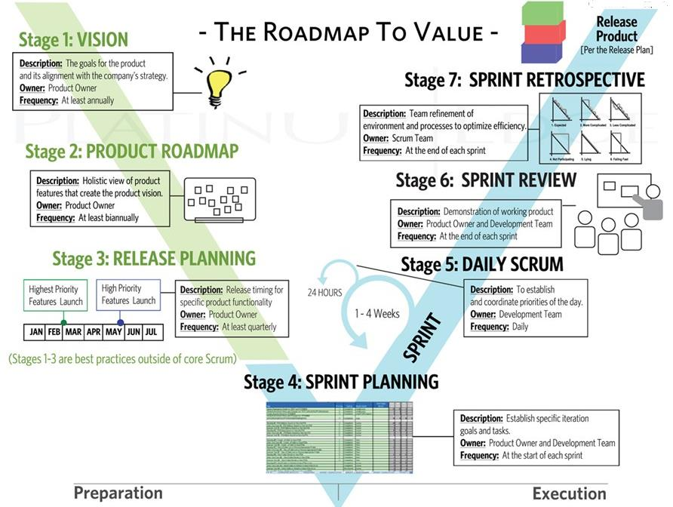
Every Stage in the SCRUM is a Review Stage!
Source: (T2)

Slide 20
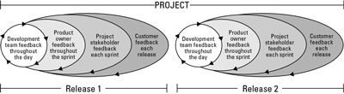
Sprint Review
Apart from demonstration of product, sprint review meeting enables stakeholders to provide continuous feedback
Each day, team members work together in a collaborative environment that encourages feedback through peer reviews and informal communication.
In each sprint, as the team completes each requirement, the product owner provides feedback by reviewing the working functionality for acceptance.
With each release, customers who use the product provide feedback about new working functionality.
Gathering feedback during the sprint review is an informal process. The product owner or scrum master can take notes on behalf of the development team, as team members are often engaged in presentations/conversations
New user stories may come out of the sprint review. The new user stories may be new features altogether, or they may be changes to the existing product or code.
After the review, the product owner has several tasks: Add any new user stories to the product backlog after prioritizing; Add stories that were scheduled for the current sprint but weren’t completed back into the product backlog and reorder/reprioritize based on the most recent priorities; Complete updates to the product backlog in time for the next sprint.
Ref: (T2-Chap9)

Slide 21
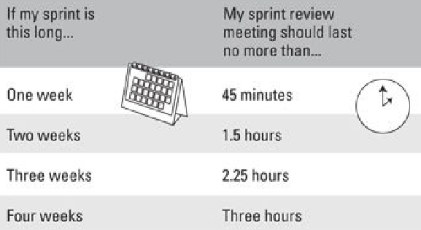
Sprint Review Meeting: Guidelines
Ref: (T2-Chap9)

Slide 22
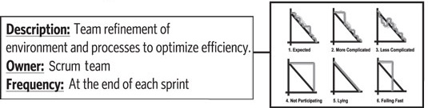
Sprint Retrospective (for Process Improvement)
SET THE STAGE
Establish the goals (specific areas of improvement) for the retrospective up front.
GATHER DATA
Discuss the facts about what went well in the last sprint and what needed improvement. Create an overall picture of the sprint; consider using a white board to write down the input from meeting attendees.
GENERATE INSIGHTS
Gather insights/ideas about how to make improvements for the next sprint.
DECIDE WHAT TO DO
Determine — as a team — identify ideas and specific actions to make them a reality
CLOSE THE RETROSPECTIVE
Reiterate your plan of action for the next sprint.
Ref: (T2-Chap9)

Slide 23
Summary: Executing a Sprint
Daily Scrum – where “action” happens (actual development)
Daily Scrum Meetings (standup meetings ~15 mins) are key to project progress and continuous improvement
All Team members work on One Story/Task at a time (to ensure swarming—collaboration & knowledge-sharing)
Each Sprint must deliver Working / Demonstrable Product
Burndown Charts & Task-boards are common tools for Project Status communication
For larger Agile Teams, Scrum-of-Scrums approach is followed (nesting of Scrum within larger Scrum)
Sprint Review Meeting is where issues/challenges faced in the last Sprint discussed, working product demonstrated and product-backlog gets updated
All improvements related to Scrum Process and Team collaboration and communication are addressed in Sprint Retrospective Meeting

Slide 24
Thank You
© Copyrights of original Authors are duly acknowledged
™ ® All Trademarks, Registered Trademarks referred in this document are the property of their respective owners

